Slide 1
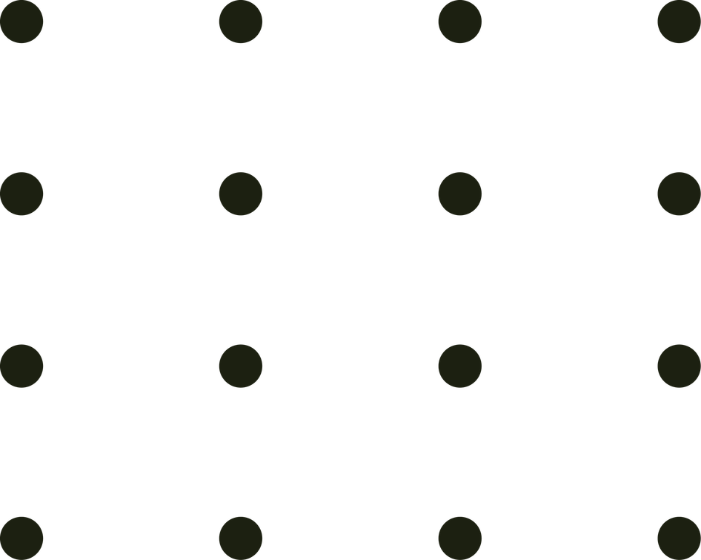

Image Processing ( ARTI 404 )
LIGHTWEIGHT ATTENTIVE RESIDUAL U-NET
FOR IMAGE DENOISING
LAR-U-Net model for Image Denoising
Advisor: Mohammad Aftab Alam Khan
University: Imam Abdulrahman Bin Faisal University

Slide 2

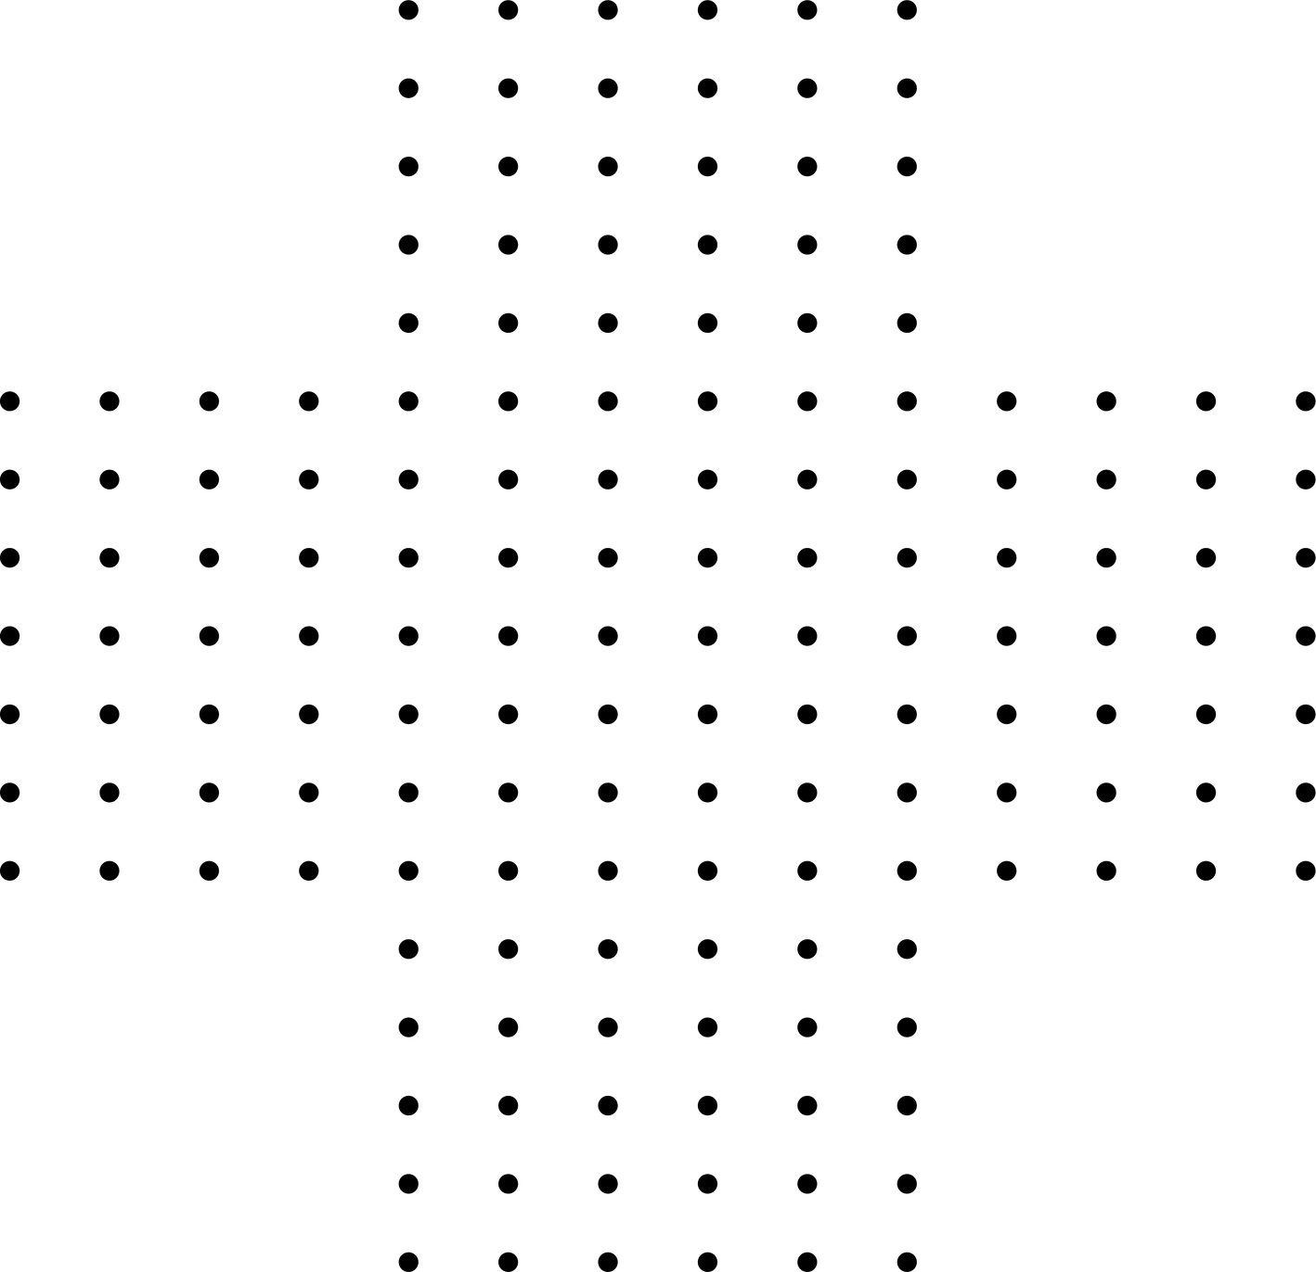
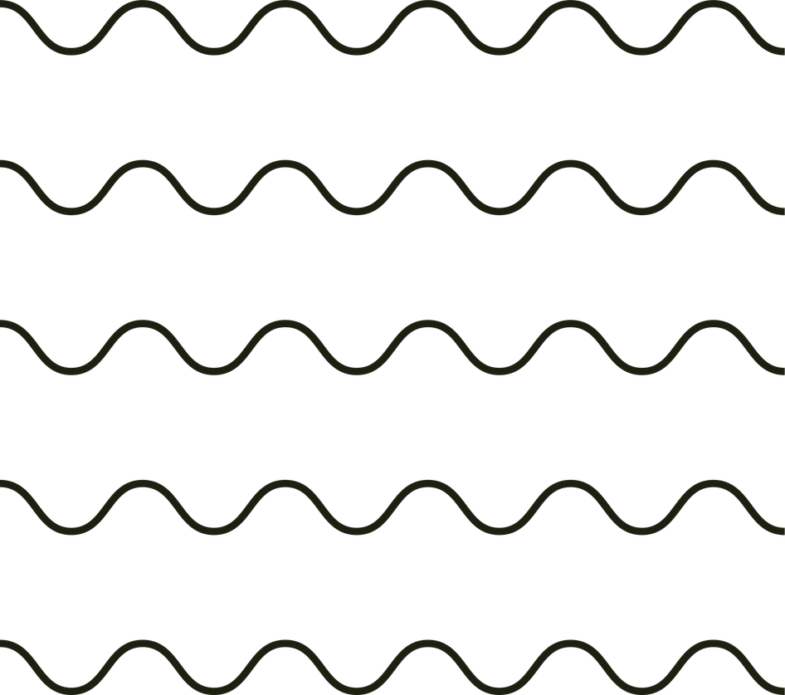
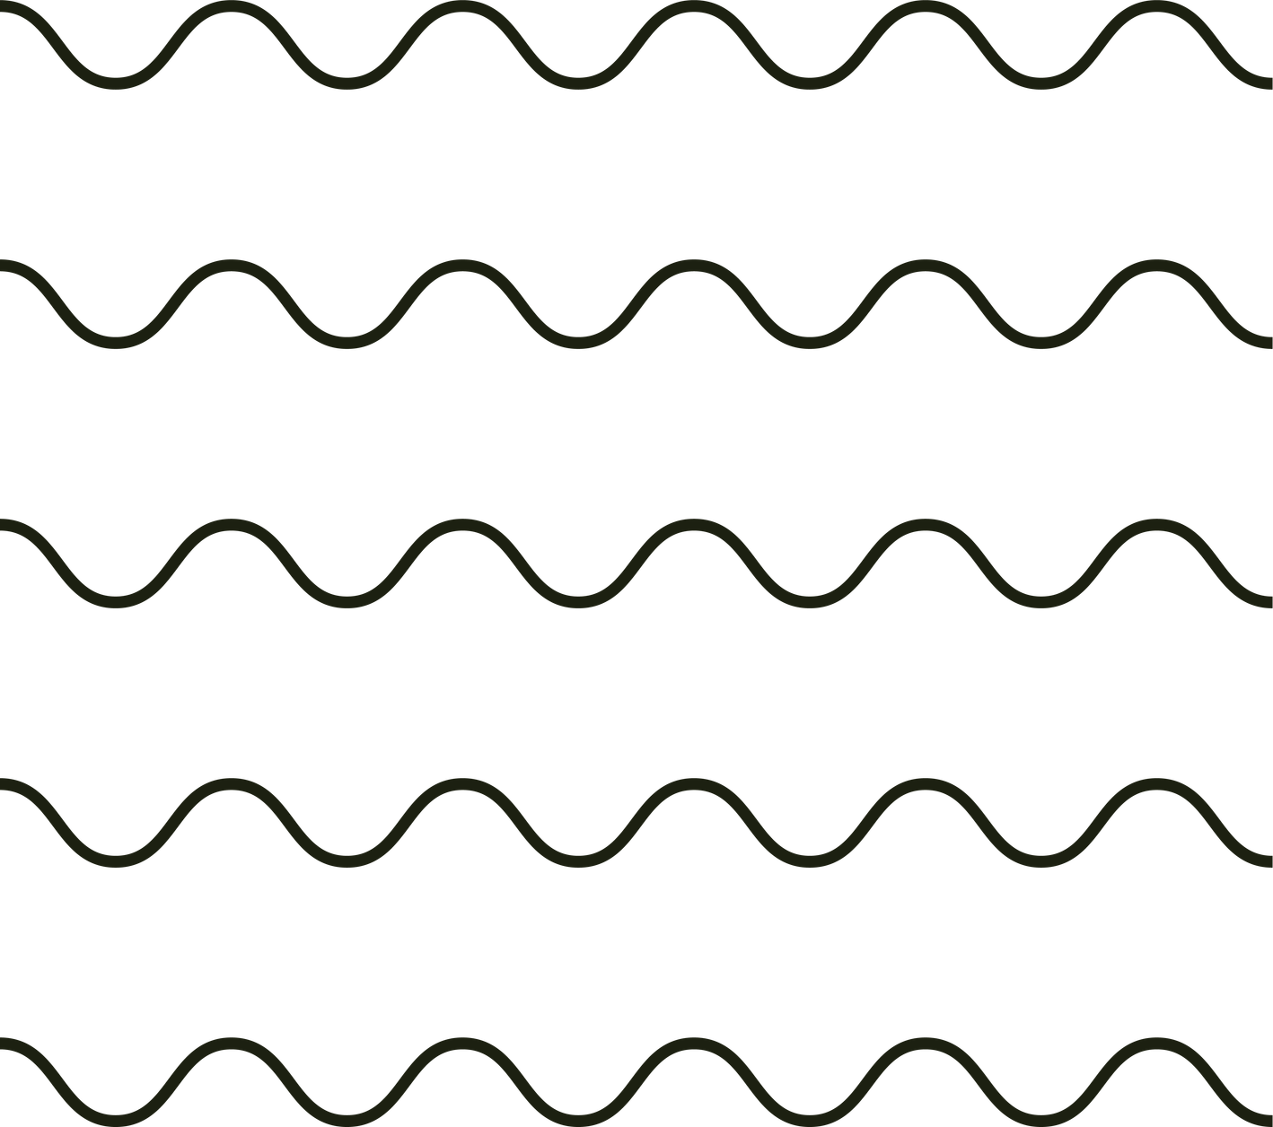
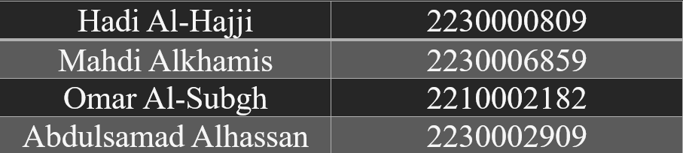
Overview
Introduction
Research Objectives
Literature Review
Methodology (Model Proposed)
Data Acquisition and Preprocessing
Evaluation and Analysis
Conclusion

Slide 3
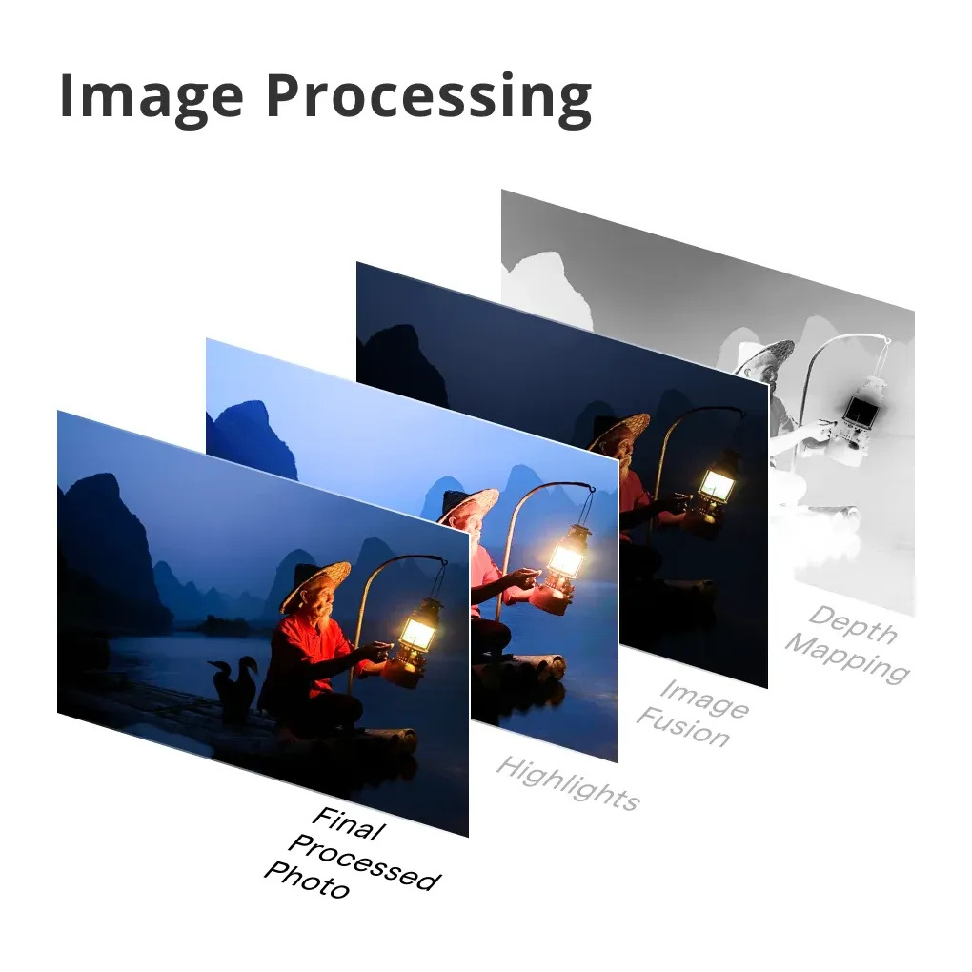

Introduction -Hadi Al-Hajji
Image noise is caused by factors such as randomness and external disturbances in the imaging process, and it may lead to problems such as blurred image details, blurred edges, and color variations.
The core challenge is “denoising”: effectively suppressing high-frequency noise components while preserving critical structural features, such as sharp edges and fine textures.

Slide 4



Research Objectives-Hadi Al-Hajji
Fixing the Image: Take a noisy picture (y) and separate it into a clean picture (x) and the noise (v). This follows a simple formula: y = x + v
Balancing Act: Find a "middle solution" that removes as much noise as possible without making the final image look blurry.

Slide 5
Literature Review -Hadi Al-Hajji
Deep Neural Networks for Image Denoising
Significant Findings
Brief Explanation
The Technology Shift: that moved away from traditional mathematical filters and transitioned toward deep learning neural networks.
The Core Trade-off: Traditional filters are fast but blur images, while advanced deep learning models preserve details but require more computing power.
The Attention Advantage: Adding "attention modules" to neural networks allows the AI to focus on the most important shapes and edges in an image.
DnCNN (Discriminative Model): This model uses residual learning to isolate and subtract noise within its hidden layers. It is highly effective and fast for standard grain (Gaussian noise) but struggles to restore complex textures.
CBAM-DnCNN (Attention Module Integration): By adding a Convolutional Block Attention Module, this model scores and prioritizes important features across spatial areas and color channels. This makes it accurate enough for high-stakes fields like medical imaging and self-driving cars.

Slide 6
Literature Review -Mahdi Alkhamis
U-Net and Residual U-Net Architectures
Significant Findings
Brief Explanation
Standard U-Net Architecture: Uses an encoder-decoder (U-shaped) structure. Its skip connections pass raw, low-level spatial data directly from the input side to the output side, preventing important image details from getting lost during processing.
Hyperparameter Tuning: Research shows that while adding more layers helps the model fit the data better, kernel sizes must be carefully tuned to lower the Mean Absolute Error (MAE) and prevent the AI from overfitting.
The Power of U-Net: The U-Net structure is a foundational tool for cleaning images because its shape naturally prevents the loss of background details.
Hyperparameter Sensitivity: The success of these networks depends heavily on fine-tuning internal settings (like kernel size and layer depth) to avoid learning errors.

Slide 7
Methodology (LAR U-Net) -Mahdi Alkhamis
The Input: Gradient-Augmented Processing
The Backbone: U-Net with Skip Connections
Instead of feeding only the raw, noisy image, the model utilizes Gradient-Augmented Processing. We compute the image gradients to highlight structural edges, which are then concatenated with the original image.
Operation:
Using Sobel filters to calculate horizontal (Gx) and vertical (Gy) gradients.
Kernel Choice: 3x3 kernels are used. Research suggests this is the optimal balance between error reduction and model fit.
Skip Connections: These bridge the encoder and decoder, ensuring that fine details lost during the compression layers are recovered during upsampling.
Residual Units: The network is built with residual units, which ease training and facilitate information propagation.
Why?
This forces the model to recognize "edges" immediately, preventing the over-smoothing common in basic CNN-based denoisers.
Why?
The architecture adopts the Symmetric Encoder-Decoder design of a U-Net to maintain high-resolution spatial data.

Slide 8
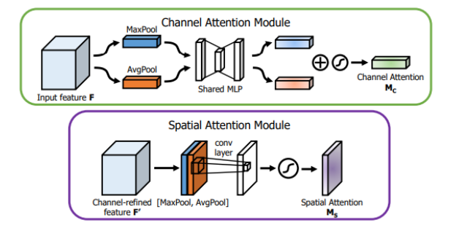
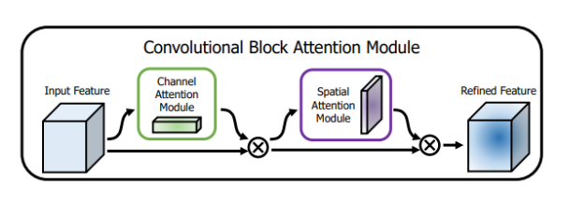
Methodology (LAR U-Net) -Mahdi Alkhamis
Simple Attention Blocks (CBAM)
To prioritize important features, a Convolutional Block Attention Module (CBAM) is inserted into each encoder layer.
Channel Attention: Identifies which feature maps contain the most relevant signal (vs. noise). This layer takes the 64 feature mappings formed in the first layer as input and then reduces the spatial dimensions of the input feature mappings to 1 by using AdaptiveAVGPool2d. Then the fc function learns the mapping of the channel weights, and finally, the sigmoid function maps the adjusted weights to each channel.

Slide 9
Methodology (LAR U-Net) -Mahdi Alkhamis
Simple Attention Blocks (CBAM)
Spatial Attention: Identifies where the noise is most destructive in the spatial grid. The Spatial Attention layer first obtains two feature mappings by calculating the mean and maximum values on the channel dimension: the mean feature mapping and the maximum feature mapping and then joins the mean feature mapping and the maximum feature mapping on the channel dimension to obtain a feature mapping. The average feature mapping and the maximum feature mapping are then connected in the channel dimension to obtain a feature mapping. This connected feature mapping contains average and maximum information about the input feature mapping. The connected feature mapping is passed through a convolutional layer (convolutional kernel size 7x7, padding 3) to perform a convolutional operation to capture the correlation between the feature mappings, thus obtaining a feature mapping representing the spatial attention weight, and finally, the output of the convolutional layer is passed through a Sigmoid function to process the output, which restricts the range of the output to be between 0 and 1, and obtains a feature mapping representing the spatial attention weight.

Slide 10
Methodology (LAR U-Net) -Mahdi Alkhamis
The Output: Residual Learning Strategy
Following the DnCNN paradigm, the model does not attempt to reconstruct the clean image directly. Instead, it predicts the noise map.
Mechanism: The predicted noise is subtracted from the original noisy input.
Advantage: It is mathematically easier to "find the noise" than to rebuild the clean image from scratch, leading to faster convergence and better stability.

Slide 11

Data Acquisition and Preprocessing -Abdulsamad
Berkeley Segmentation Dataset 500 (BSDS500), a dataset that consists of 500 natural images, ground-truth human annotations, and benchmarking code. The data is explicitly separated into disjoint train, validation, and test subsets:
Training dataset size: 200
Validation dataset size: 100
Test dataset size: 200
Multi Noises for Image Denoising dataset that contains 300 high-quality original images and their corresponding synthetically generated noisy variants using 7 common noise types: Gaussian, Speckle, Poisson, Multiplicative, JPEG Compression, Quantization, and Salt & Pepper.
These datasets are chosen to be trained in our model for the first dataset and tested on other types of noise in the second dataset.
Preprocessing
includes normalization (scaling pixels to [0,1]) and the synthetic addition of Gaussian noise using the probability density function model for the first dataset.

Slide 12


Evaluation and Analysis -Abdulsamad
How the experiments done?
Using additive white Gaussian noise (sigma = 25) (AWGN) for the BSDS500 dataset.
The model trained for 10 epochs.
Batch size is 8.
Using Adam as the optimizer function.
Using Mean Squared Error (MSE) as loss function.
PSNR (Peak Signal-to-Noise Ratio)
It is a standard engineering metric used to quantify the quality of reconstruction. It represents the ratio between the maximum possible power of a signal and the power of corrupting noise. Since the relationship is inversely proportional to MSE. We try to increase PSNR, which indicates that the Mean Squared Error is decreasing.

Slide 13
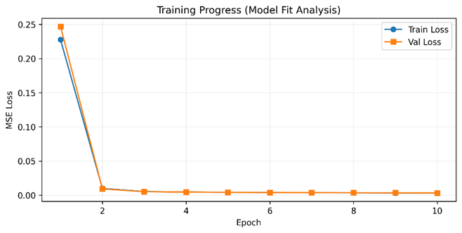
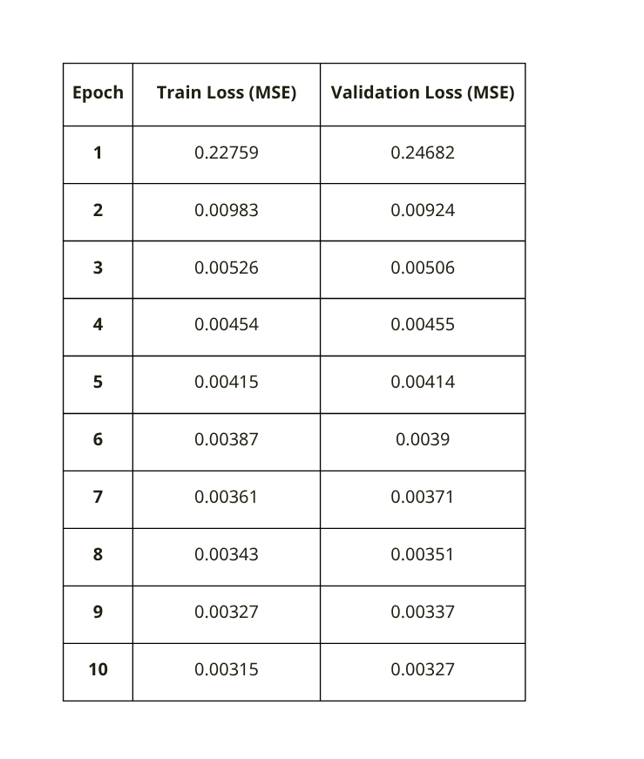
Evaluation and Analysis -Abdulsamad
The Output of our training loss and validation loss of the model:

Slide 14
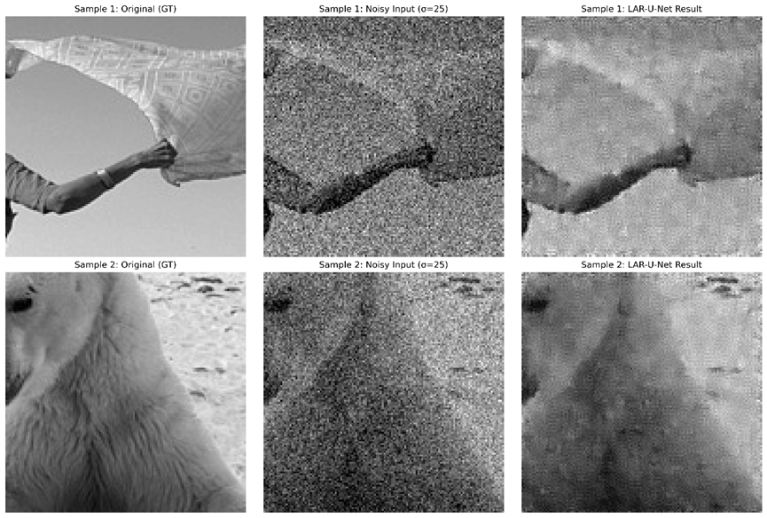
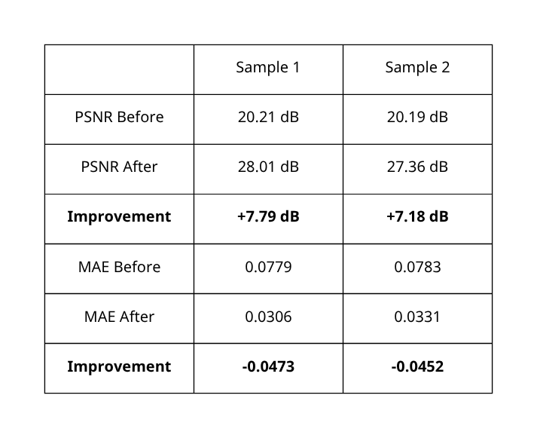
Evaluation and Analysis -Abdulsamad
Visualize two samples:

Slide 15
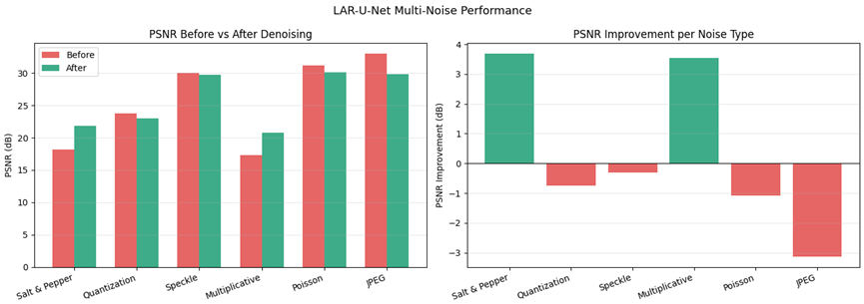
Evaluation and Analysis -Omar Al-Subgh
Visualize test samples:
Our model has a positive effect on both:
Salt & pepper
Multiplicative noises
that are more than 3 dB in PSNR.
But when focusing on the image of visualization, we easily see that no meaningful change happened.

Slide 16
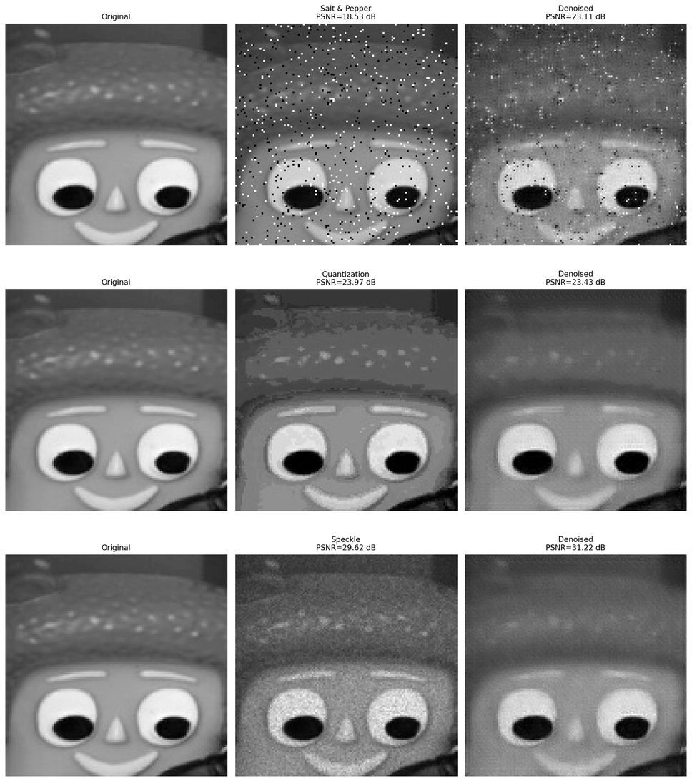
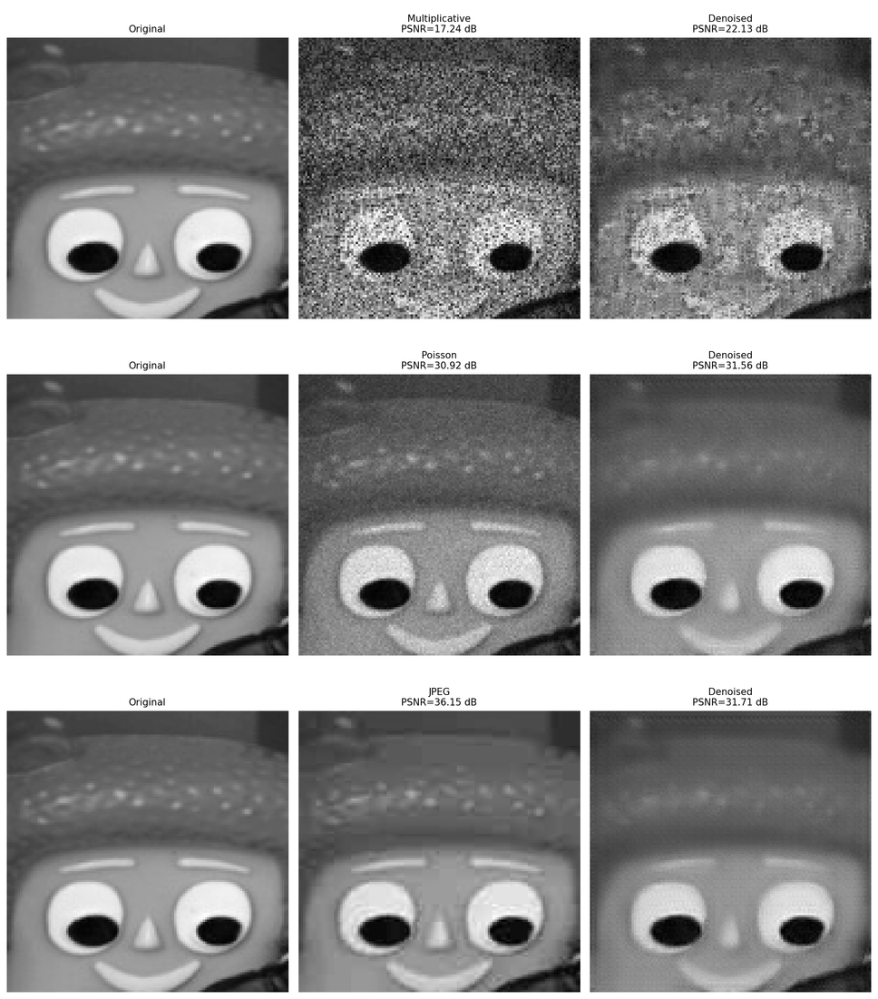
Evaluation and Analysis -Omar Al-Subgh
Visualize test samples:
More experiments with several types of noises to see if our model could improve the noisy image and be much clearer.

Slide 17

Conclusion -Omar Al-Subgh
Sum up of our research
We introduced the LAR–U-Net model, which uses the residual U-Net combined with the Convolutional Block Attention Module (CBAM) inserted into each encoder layer and MSE as the loss function that makes our model designed specifically for grayscale image Gaussian denoising.
We achieve an average of PSNR (19.921 dB) for the test dataset with an exceedance of (+7 dB) on some samples. Our lightweight model with this simple architecture achieves quite a low average of PSNR that leads us to continue searching for new improvements to our solution.
The good results from LAR–U-Net prove that lightweight attention tools work well for fixing random image noise. In the future, we will try new training methods and add more layers to keep image details from getting blurry.

Slide 18




Q&A Session
Thank You for Listening!

